Slide 1
Author Attribution
Liz Sheffield
EN 605 744 81

Slide 2
Problem Statement
When identifying the poet for a given stanza of text, are morphological/phonological/style statistics more relevant than word choice?
Q1: Can binary or tf-idf classifiers be effective on a corpus of poetry stanzas
Q2: Is Stanza length or Line Length more useful?
Q3: Is Rhyme Scheme useful in classification?
Notes:
Talk about the tags classification

Slide 3
Process
Create Base Corpus
Create Classification Set
Create Corpus for Syllable/Rhyme Test
Test Classifiers
Refine Classifiers
Perform Corpus Analytics
Create Analytics Based Classifier
Compare

Slide 4
Corpus Creation

Slide 5
Meet the Authors
Maya Angelou
Our Grandmothers
Emily Dickinson
I measure every Grief I meet
Robert Frost
The Road Not Taken
The Black Family Pledge
The Traveller
Son to Mother
Phenomenal Woman
Still I Rise
Caged Bird
Alone
Touched By An Angel
Woman Work
Men
Song for the Old Ones
High From The Earth I Heard A Bird
I cannot live with you
How fits his Umber Coat
Severer Service Of Myself
Nature—sometimes Sears A Sapling
Whole Gulfs - of Red, and Fleets
Said Death To Passion
The inundation of the Spring
"Heaven"—Is What I Cannot Reach!
A Book
A Bird Came Down
"Faith" Is A Fine Invention
"Why Do I Love" You, Sir?
Hope Is The Thing With Feathers
Fire And Ice
Stopping By Woods On A Snowy Evening
Acquainted With The Night
Nothing Gold Can Stay
A Late Walk
A Question
Pea Brush
New Hampshire
The Times Table
Edgar Allan Poe
Walt Whitman
Annabel Lee
A Dream Within A Dream
Alone
The Raven
Eldorado
A Dream
Evening Star
Ulalume
To Isadore
The City Of Sin
To Marie Louise (Shew)
The Bells - A Collaboration
The Divine Right Of Kings
Stanzas
The Return Of The Heroes
Washington's Monument, February, 1885
The Great City
O Captain! My Captain!
A Clear Midnight
A Child Said, What Is The Grass?
A Noiseless Patient Spider
A Glimpse
A Child's Amaze
A Woman Waits For Me
Song Of Myself, XXXVI
Broadway
Song Of Myself, IV
Song Of Myself, VIII
Notes:
I wanted to use about 50 stanzas for the first test, but I started with Frost and to get to 50 I ended up going over to 60

Slide 6
Corpus Assembly
<P ID=F1>
Two roads diverged in a yellow wood,
And sorry I could not travel both
And be one traveler, long I stood
And looked down one as far as I could
To where it bent in the undergrowth;
</P>
<P ID=F1>
[tU] [r@Udz] [dI][v3:dZd] [In] [@] [jE][l@U] [wUd]
[N,] [sO][rI] [aI] [k@d] [n] [tr&][vl,] [b@UT]
[N,] [bI] [wVn] [tr&][vl,][@r*] [lON] [aI] [stUd]
[N,] [lUkt] [daUn] [wVn] [&z] [fA:r*] [&z] [aI] [kUd]
[tu:] [hwE@r*] [It] [bEnt] [In] [D] [Vn][d@][gr@UT]
</P>
99614\wood\1166\51927\1\P\'wUd\[CVC]\[wUd]
Notes:
More difficult than initially thought, though was warned
CELEX – lexical database that includes Orthography, lemmas, phonology, morphology, etc. I particularly used EPQ with is the phonology dataset, required manual cleanup

Slide 7
Classification
Token-Based

Slide 8
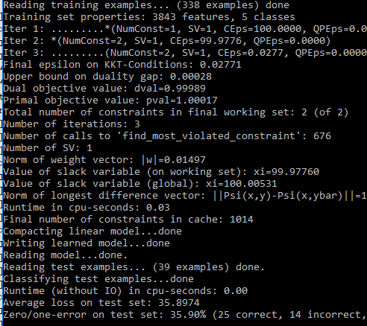
Binary Classification Results
Binary Classifier:
(25 correct, 14 incorrect, 39 total)
Binary Punctuation Classifier:
(11 correct, 28 incorrect, 39 total)
Binary Stop Word Classifier:
(25 correct, 14 incorrect, 39 total)

Slide 9
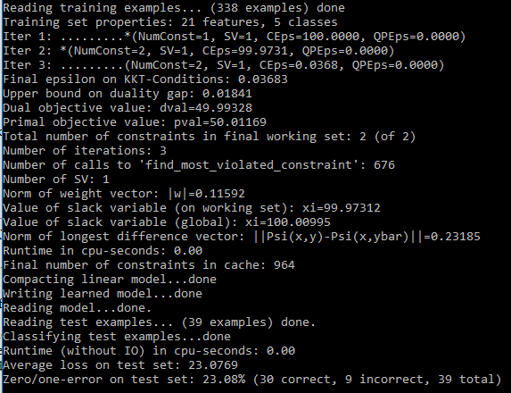
Vector Based Classification Results
Binary Classifier:
(24 correct, 15 incorrect, 39 total)
Punctuation Classifier:
(11 correct, 28 incorrect, 39 total)
Stop Word Classifier:
(30 correct, 9 incorrect, 39 total)

Slide 10
Classification
Non-token Based

Slide 11
Word Density
This looked at how many lines occurred within a stanza and how many words occurred in a line to determine if there were any clear trends.
Results:
If (Stanza has >= 10 lines) OR
If (Line has >= 10 words)
Dickinson --
Angelou --

Slide 12
Line Statistics
This looked at the occurrence of alliteration and repetition, two frequent facets of poetry, within each line.
Results
If (line contains Repetition)
Poe++, Whitman++
If (line contains alliteration)
Frost++, Poe++, Whitman++

Slide 13
Syllables
The length of a line and syllable can be looked at in terms of words and syllables, Frost, Poe, and Whitman were far more verbose.

Slide 14
Syllable Counts
The number of multi-syllabic words was a distinguishing factor with Whitman, Poe, and Frost being more verbose.

Slide 15
Rhyme
Looking at the last syllable of each line determined if a rhyme scheme was present. The stanza distribution was too diverse to used rhyme scheme [ABA] to identify an author, so the mere presence of a scheme was used.

Slide 16
Results
PENDING – I’m currently running the last set of refinement on the analysis based classification, but so far it appears that this will yield higher than the best 71.79%

Slide 17
References
Türkoğlu F., Diri B., Amasyalı M.F. (2007) Author Attribution of Turkish Texts by Feature Mining. In: Huang DS., Heutte L., Loog M. (eds) Advanced Intelligent Computing Theories and Applications. With Aspects of Theoretical and Methodological Issues. ICIC 2007. Lecture Notes in Computer Science, vol 4681. Springer, Berlin, Heidelberg
McColly, W. & Weier, D. Comput Hum (1983) 17: 65. https://doi.org/10.1007/BF02277126
Diederich, J., Kindermann, J., Leopold, E. et al. Applied Intelligence (2003) 19: 109. https://doi.org/10.1023/A:1023824908771
https://catalog.ldc.upenn.edu/docs/LDC96L14/celex.readme.html
https://www.poemhunter.com

